Slide 1
Fraser Public Schools
The Fraser Journey

Slide 2
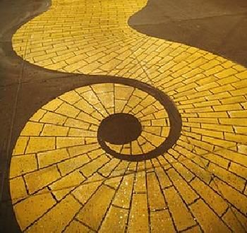
Building Capacity -
Where the Rubber Meets the Road
CBL and Curriculum Alignment
Learning Management System -
itslearning
Web Presence
and
Connectivity
District Teams and Instructional Technology
Committee
Instructional Design -
Modern Teacher
Vision
Tech
Bond
Device Rollout
Apple PD and
SAMR
21st Century Teachers
Laying the Foundation
UDL

Slide 3
District Teams and Instructional Technology Committee
Building Teams and Leaders
Technology Committee
Principal Leadership
21st Century Teachers
Role of Curriculum and Technology
Growing Capacity and Shared Leadership

Slide 4
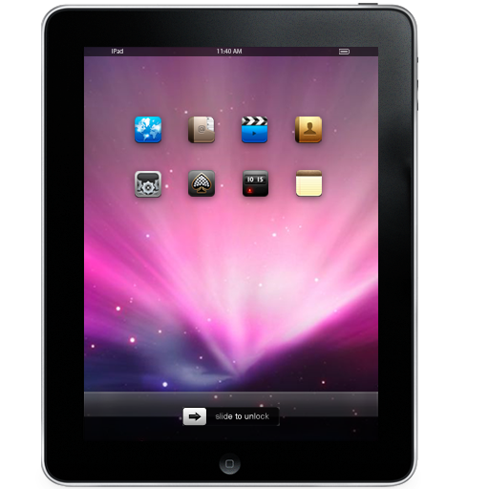
Device Rollout
1:1 Mobile Computing Timeline
Spring/Summer 2012 - Teacher Mac Laptops & iPads
School Start September 2012 – iPad Carts
October 2012 – DK thru 2nd Grade iPad Sets & 3rd thru 6th Grade 1:1 iPads
November 2012 – 7th thru 8th Grade 1:1 iPads
February 2013 – 9th thru 12th Grade 1:1 iPads

Slide 5
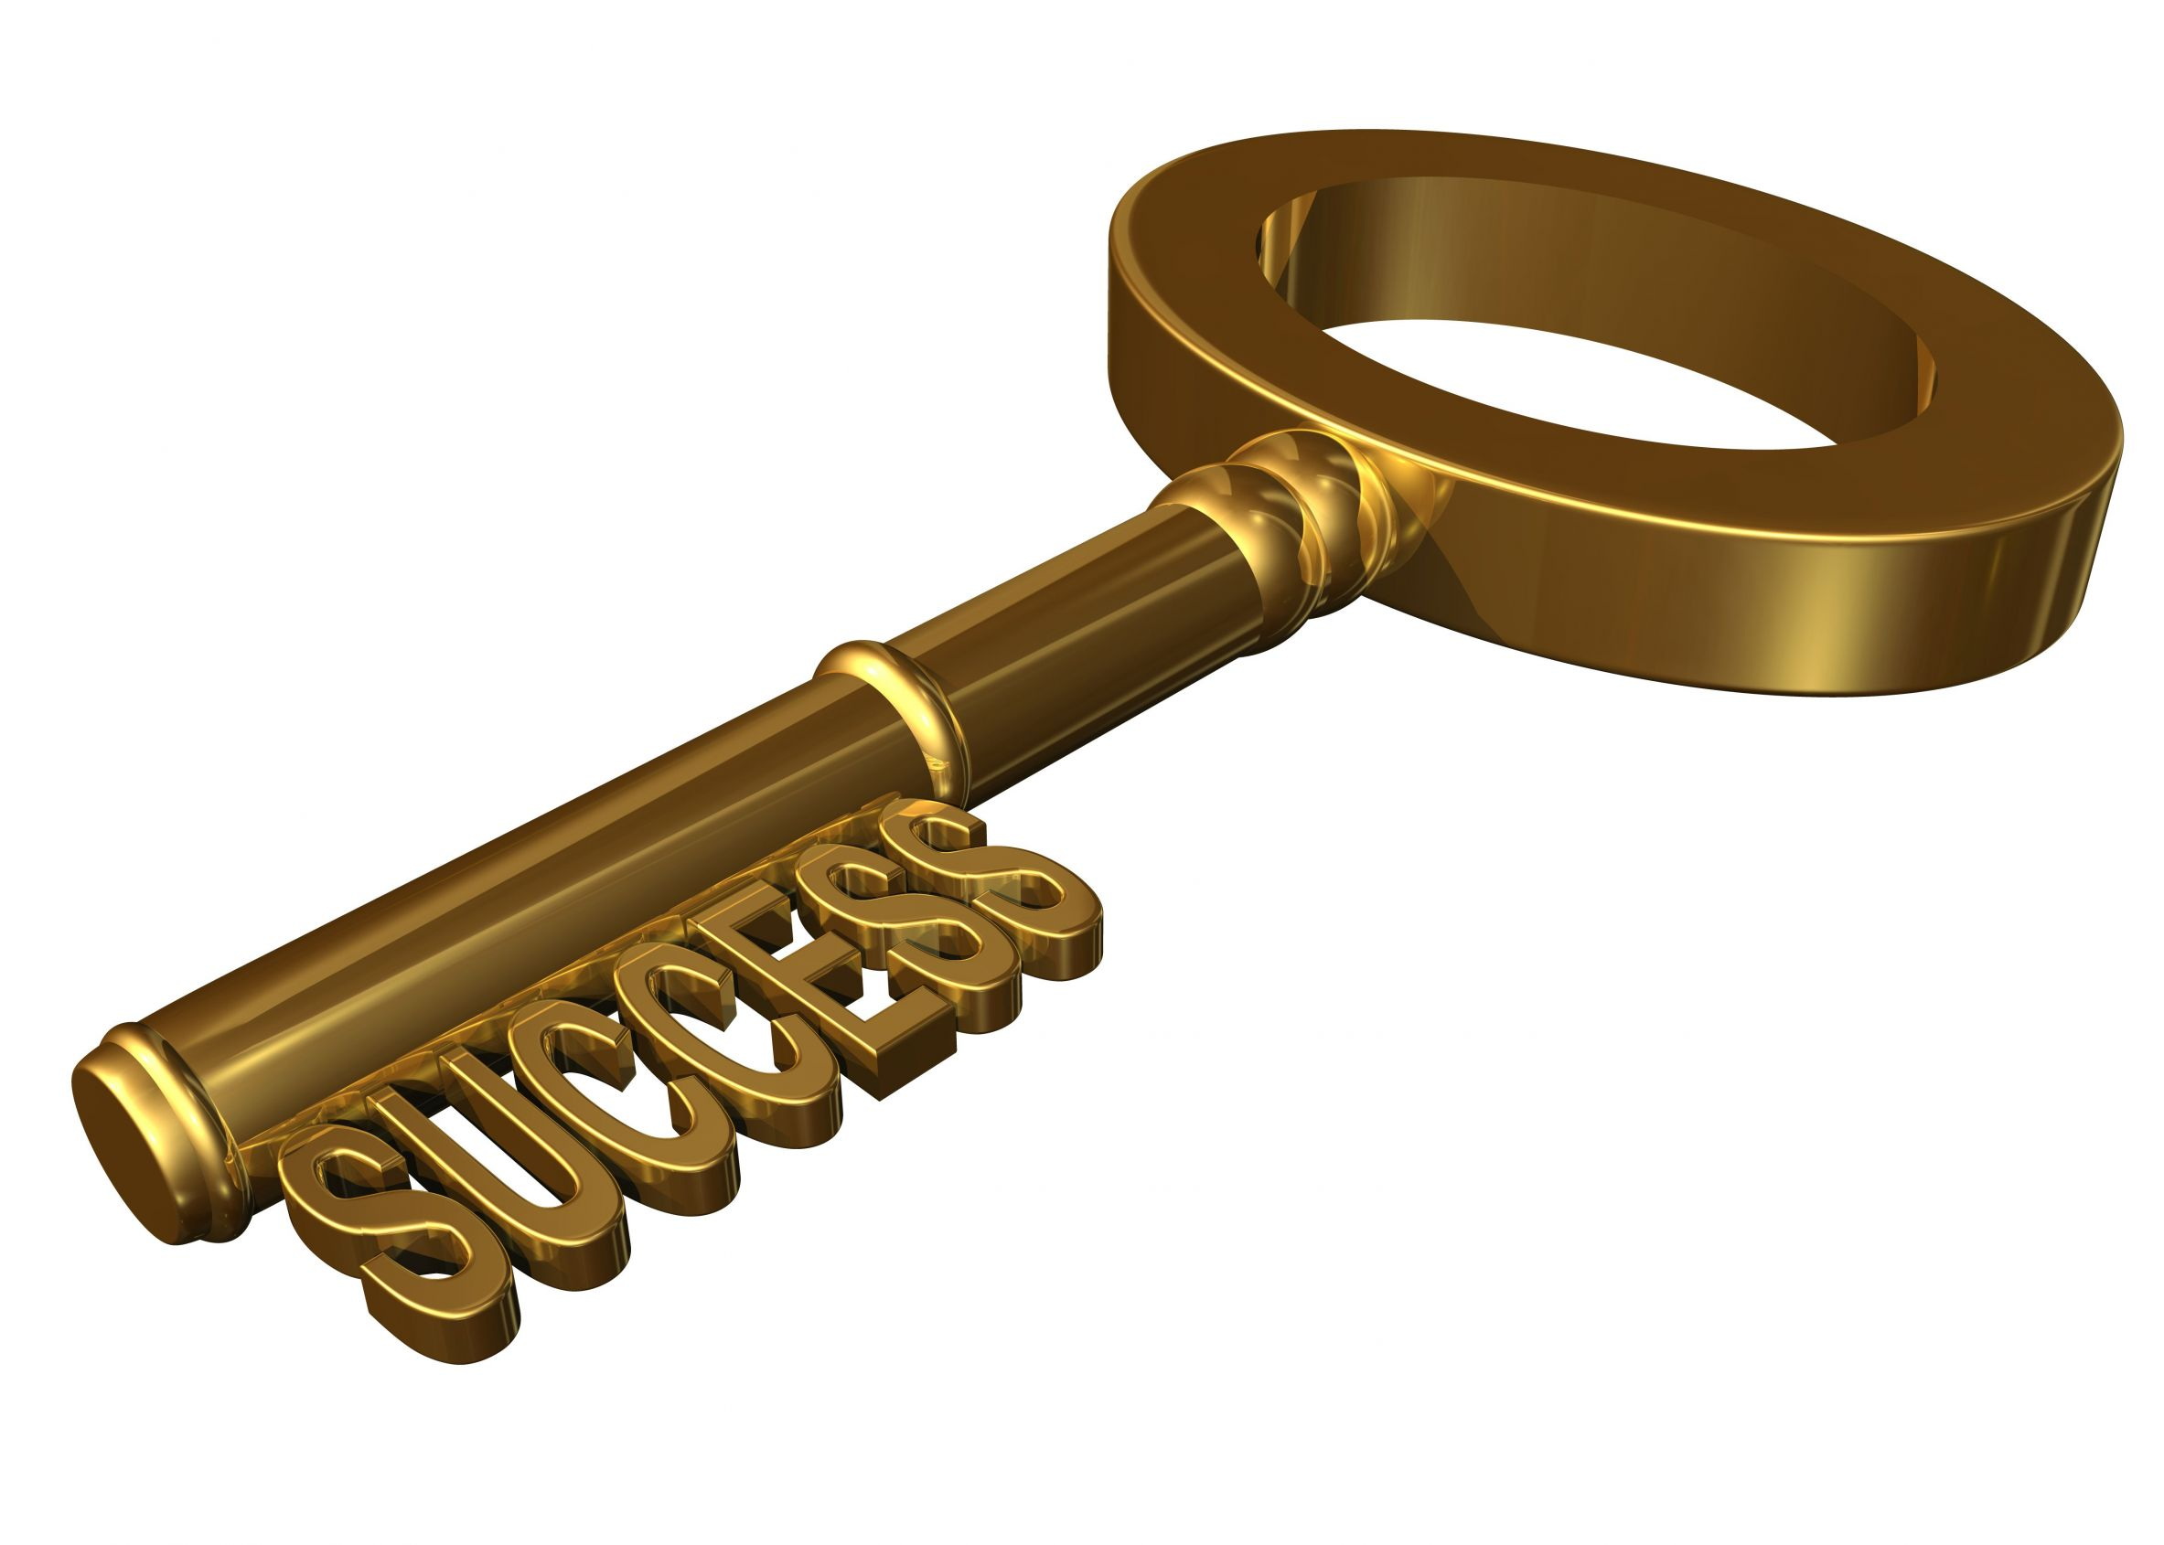
21st Century Teachers
A critical key to success – Coaching and Modeling at all levels.
Mentor staff members
Lead Professional Development
Classroom Instruction (K-6 – 21st Century Literacy Cass)

Slide 6
Laying the Foundation Universal Design for Learning
UDL is a research-based approach to teaching, learning and assessment that draws on brain research and new media technologies to respond to individual learner differences and interests.
This approach laid the early foundation of our Professional Development and Digital Conversion.

Slide 7
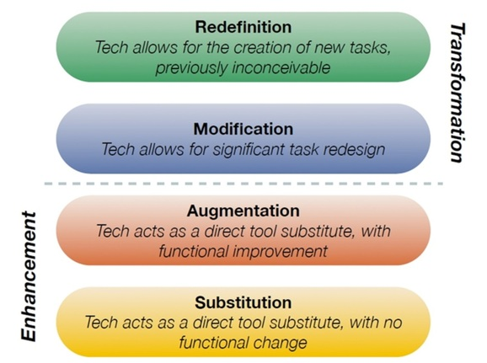
Apple PD and SAMR
Instructional Professional Development
Mac and iOs Basics
Apple Professional Development
21st Century Teacher - Train the Teacher
Online Tutorials/MyFPS
SAMR Model

Slide 8
Instructional Design – Modern Teacher
Our 21st century Instructional Design Road map:
Professional Development
Common Language
Shared sense of purpose and vision
Digital Platform
Curriculum Planning and Design Templates

Slide 9
Learning Management System - itslearning
At the end of the 2013-2014 School Year, we adopted a new Strategic Plan that focused on customized learning for all students.
In the Summer of 2014, we committed to a new district wide Learning Management System – itlsearning.
IItslearning provides us the digital space that is transparent for teachers to access and use in a meaningful way.

Slide 10
Competency Based Learning and Curriculum Alignment
In order to customize the learning experience and implement a competency based learning model, we needed to have defined competencies that are vertically aligned by both grade level and between courses.
By the end of the 2014 – 2015 school year, we will have developed a DK – 12th Grade vertically articulated road map of critical competencies we expect of a Fraser Graduate! This work is being completed through the PLC Process.

